Slide 1
Calibration Quality
Comparing single trial registration matrix to “ground truth” registration matrix obtained from a combined 24 trials

Slide 2
Kuka→ Aruco Aruco→KUKA Registration
29 calibration trials captures→ 5 for repeatability +24 for registration matrix
JSON Calibration
Get registration matrix ( source=JSON, target=aruco X24 trials)

Slide 3
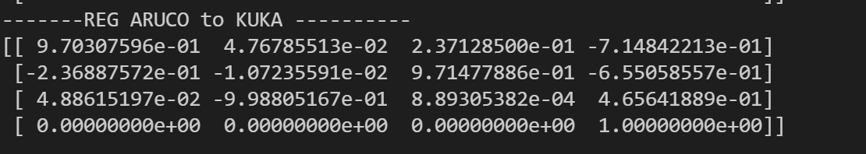
Registration matrix (24 trials)
= GROUND TRUTH
** Original in meters: analysis later converted to millimeters
Notes:
** in meters

Slide 4
Repeatability of Registration
Take 5 Trials ( 4 positions each)
Calculate their individual registration matrix T
Get mean and std of each T component ( for Rotation and translation matrices)
Calculate their respective bias
Calculate their respective TAE: total analytical error
Notes:
*** original registration matrixes are in m
Reported bias, means and std are in mm

Slide 5
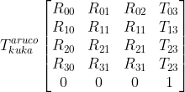
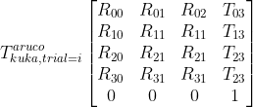
Registration matrix obtained from 24 trials = “Ground Truth”
Get registration matrix for each of the 5 trials used for repeatability.
Get their combined component means and std.
Compare with ground truth
Notes:
T_{kuka}^{aruco}\begin{bmatrix}
R_{00}& R_{01}& R_{02}& T_{03}\\
R_{10}& R_{11}& R_{11}& T_{13}\\
R_{20}& R_{21}& R_{21}& T_{23}\\
R_{30}& R_{31}& R_{31}& T_{23}\\
0& 0& 0& 1
\end{bmatrix}

Slide 6
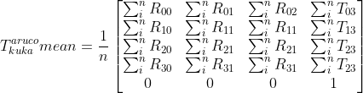
Mean matrix
Not that intuitive!
Get the element mean:
Notes:
T_{kuka}^{aruco} mean = \frac{1}{n}\begin{bmatrix}
\sum_{i}^{n}R_{00}& \sum_{i}^{n}R_{01}& \sum_{i}^{n}R_{02}& \sum_{i}^{n}T_{03}\\
\sum_{i}^{n}R_{10}& \sum_{i}^{n}R_{11}& \sum_{i}^{n}R_{11}& \sum_{i}^{n}T_{13}\\
\sum_{i}^{n}R_{20}& \sum_{i}^{n}R_{21}& \sum_{i}^{n}R_{21}& \sum_{i}^{n}T_{23}\\
\sum_{i}^{n}R_{30}& \sum_{i}^{n}R_{31}& \sum_{i}^{n}R_{31}& \sum_{i}^{n}T_{23}\\
0& 0& 0& 1
\end{bmatrix}

Slide 7
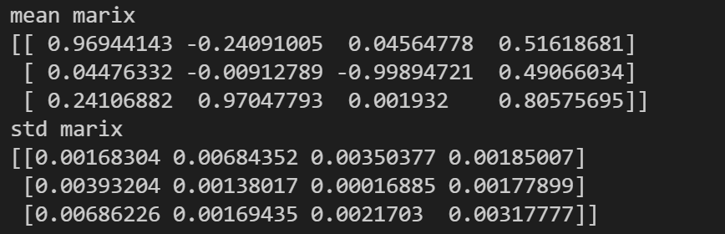
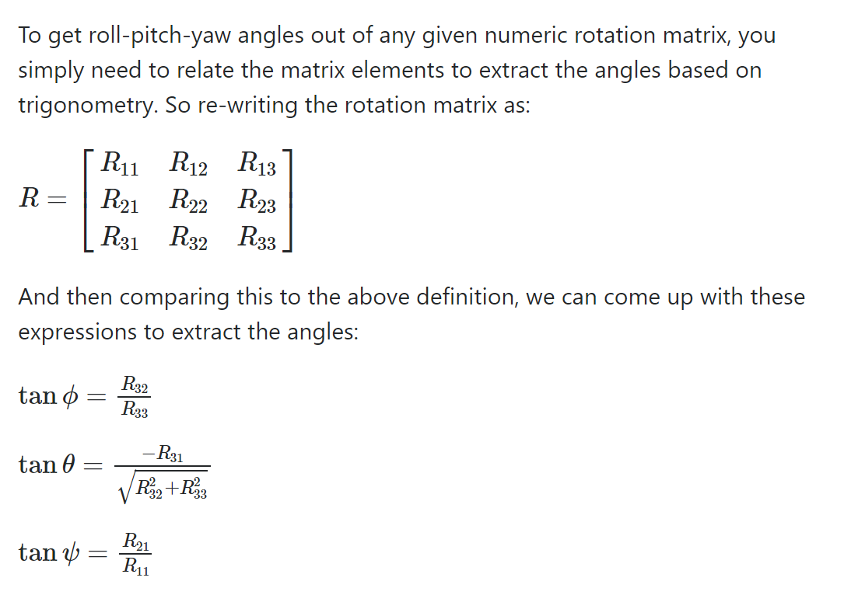
Mean Matrix [m]
Not that intuitive!
Alpha ( phi)= 89.89 deg
Beta (theta) =-13.95 deg
Gamma (psi) = 2.644 deg

Slide 8
Change of Approach
Rotation matrix elements are not intuitive➔ get equivalent roll,pitch, yaw angles for analysis
Get row, pitch, yaw for every single trial
Get mean and standard deviation
Mean, and Standard deviation of tx,ty,tz

Slide 9
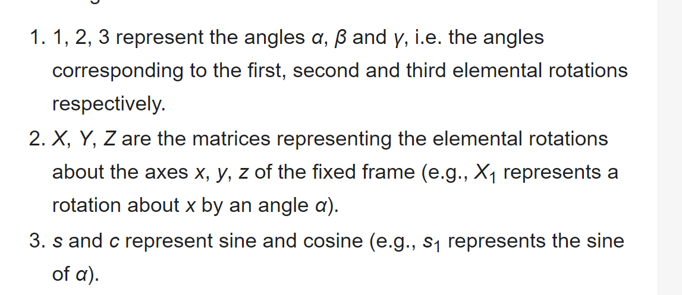
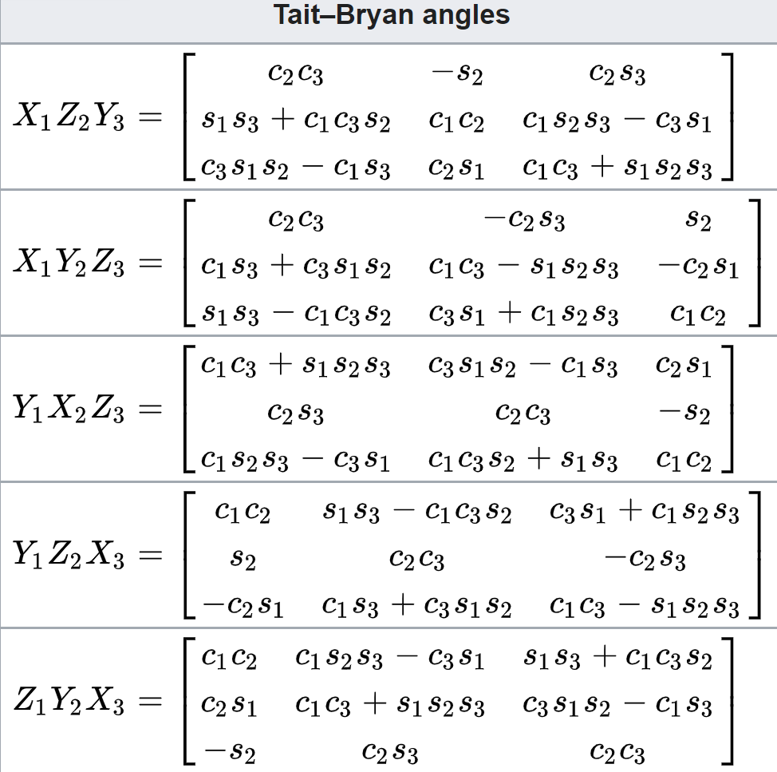
Rotation R convention
R= product of “3 elemental rotation matrices”:
ZYX Euler angles (roll, pitch, yaw)
https://en.wikipedia.org/wiki/Euler_angles

Slide 10
Notes:
When you actually solve for these angles you'll want to use an atan2(y,x) type of function so that quadrants are appropriately handled (also keeping the signs of the numerators and denominators as shown above).
Note that this analysis breaks down when cosθ=0cos⁡θ=0, where there exists a singularity in the rotation -- there will be multiple solutions.

Slide 11
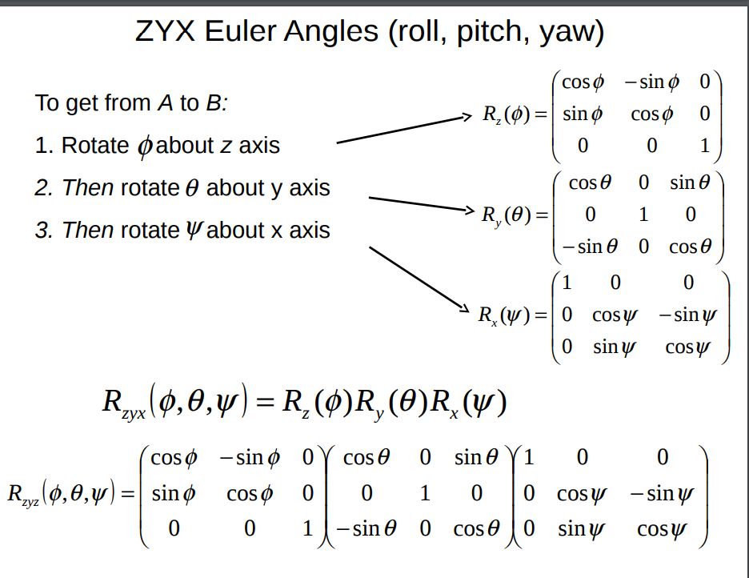
Roll, pitch, yaw

Slide 12
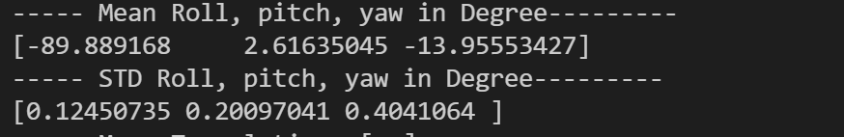
Roll, pitch, yaw Stats in deg
From each trial’s registration matrix, get the roll, pitch, yaw angles ( degrees) from its rotation matrix
➔ Calculate mean and std over the 5 trials

Slide 13
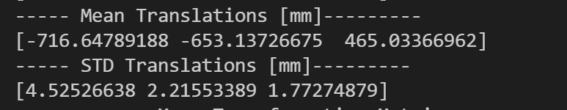
Translation Stats in mm

Slide 14
Not that intuitive!
Alpha ( phi)= 37.98 deg
Beta (theta) = -68.14deg
Gamma (psi) = 66.83 deg
Notes:
https://en.wikipedia.org/wiki/Euler_angles
https://math.stackexchange.com/questions/147028/are-euler-angles-the-same-as-pitch-roll-and-yaw
Let’s go back to the fundamentals. Euler’s rotation theorem (from 1775) states that the orientation of one 3D coordinate frame with respect to another can be described by “successive rotation about three axes such that no two successive rotations are about the same axis”. However there are twelve different permutations of rotations about three axes that meet Euler’s criteria: XYX, XYZ, XZX, XZY, YXY, YXZ, YZX, YZY, ZXY, ZXZ, ZYX, ZYZ.
Eulerian (after Euler) involves repetition, but not successively, of rotations about one particular axis: XYX, XZX, YXY, YZY, ZXZ, or ZYZ.

Slide 15
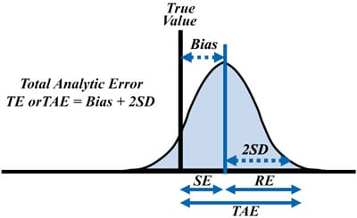
Bias and TAE
Calculate Bias for translation and angles
Calculated TAE
*** Ground Truth is the Calibration Registration Matrix, and its corresponding angles, derived from 24 trials!

Slide 16
TAE
Includes imprecision and trueness ( bias) [1]
TE (total error, a.k.a. total analytical error) – The sum of random error (imprecision) and systematic error (bias or inaccuracy). [2]
Notes:
https://pubmed.ncbi.nlm.nih.gov/28153359/
https://cdn.ymaws.com/www.asvcp.org/resource/resmgr/QALS/Allowable_Error/ASVCP_Allowable_Total_Error_.pdf

Slide 17
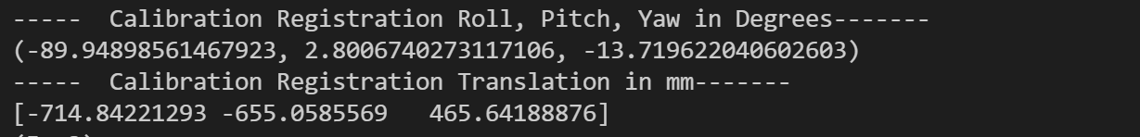
Ground Truth ( aruco→ kuka)

Slide 18
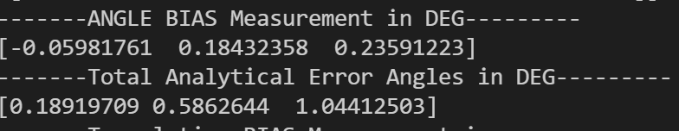
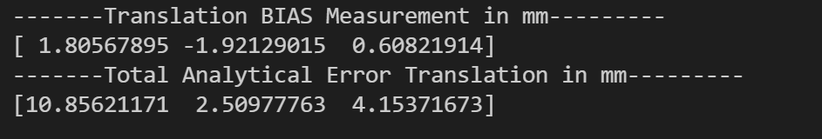
TAE
Angles [deg]
Translation [mm]

Slide 19
GT and TAE all together
Takeaways: Comparing the single trial to 24 trials derived registration matrix, gives the corresponding bias and TAE.
BIAS & Error of rotational angles ( roll, pitch, yaw) <1 deg
BIAS of translation <2mm. TEA: shows that translation is more imprecise with single trials ( only 4 point coordinates)
➔ Realsense to kuka registration calibration should use more than 4 points to obtain the registration matrix, to reduce the TAE. TAE depends on the repeatability of the robot, as well as the noise of the aruco marker
➔ Evaluation of position and tracking will thus be done using the 24 trials-based registration matrix. Future recommendations: optimize the registration precision and accuracy .

